Slide 1
SURF 2024 - 3rd Meeting
Ryan Hsieh 2024/06/06

Slide 2
AGENDA
Power Flow & Unit Commitment
MidWest Region States & County Data
Bus Types Differences
Plant Types Differences

Slide 3
Power Flow & Unit Commitment
Power Flow (Load Flow) analysis : determine the voltage levels, power flows (both real and reactive), and losses in a power system under steady-state conditions
Methods Used:
Newton-Raphson: Iterative method known for its robustness and convergence properties.
Gauss-Seidel: Simpler iterative method, less commonly used for large systems due to slower convergence.
Objectives:
Voltage Profile: Determining the voltage magnitude and angle at each bus in the system
Power Flow: Calculating the real (P) and reactive (Q) power flows on transmission lines
System Losses: Identifying losses in the system to improve efficiency
Unit Commitment analysis : determining the schedule for turning on and off power generation units to meet forecasted demand at the lowest cost while satisfying operational constraints
Steps:
Combine plant, gencost, bus, and demand data for a comprehensive view
Define Constraints and Costs
[Add Scenario in PowerSimData] Include generation limits (Pmin, Pmax), ramp rates, startup/shutdown costs, and operational statuses
Use demand profiles from demand.csv to understand load requirements over time
Formulate Optimization Problem\
Objective: Minimize total generation cost, including startup, shutdown, and running costs
Constraints: Ensure generation meets demand, adhere to ramp rates, and respect operational limits
Solve Optimization Problem

Slide 4
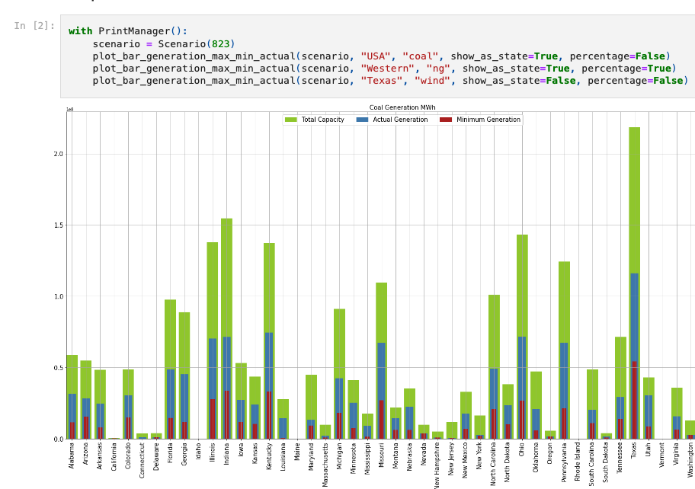
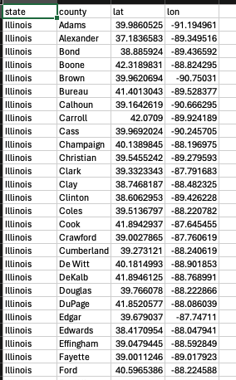
MidWest Region States & County Data
Data generated:
States in MidWest Region in order
W/ all counties & coordinates
Can be linked to all other data with longitude and latitude
Problem?
How to use them

Slide 5
Bus Types Differences
FOUR TYPES OF BUS

Slide 6
Four Types of BUS
PQ Bus (Load Bus)
3. Ref Bus (Slack Bus)
4. Isolated Bus
2. PV Bus
(Generator Bus)
Most Common Bus
Specified: Real power (P) and reactive power (Q)
Unknown: Voltage magnitude (V) and phase angle (θ)
Role: Represents loads consuming a specified amount of power
Critical for Load Flow Studies: PQ buses are essential for load drift analysis
Often used for generator buses
Specified: Real power (P) and voltage magnitude (V)
Unknown: Reactive power (Q) and phase angle (θ)
Role: Represents generators maintaining a specified voltage
reference point for voltage and phase angle
Voltage magnitude (V) and phase angle (θ)
Unknown: Real power (P) and reactive power (Q)
Role: Balances power in the system, absorbing excess power or supplying deficit
Rarely used & Not used in Base Data
Specified: No power exchange with the system (isolated)
Role: Represents buses that are not connected or participating in power flow

Slide 7
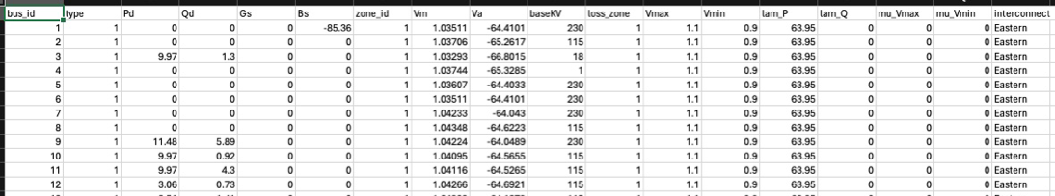
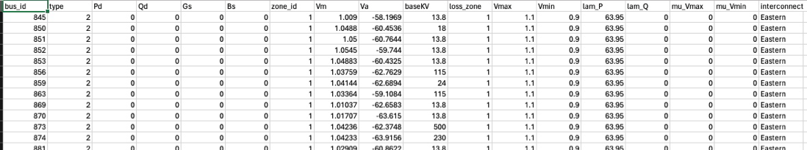
Bus Data Comparison
PQ Bus (Load Bus)
2. PV Bus (Generator Bus)
3. Ref Bus (Slack Bus)
Pd = Real Power Demand
Qd = Reactive Power Demand
PQ mostly value greater than 0
PV mostly 0
Gs = Shunt Conductance
Bs = Shunt Susceptance
Both stay 0 mostly
Not sure the use
Vm = voltage magnitude
Va = voltage phase angle
Base_kv = Base voltage level in certain area
PQ > PV (PQ more stable in greater than 100, PV fluctuate alot)
Vmax/Vmin = max and min voltage in pu
Iam_P/Iam_Q = Lagrange multiplier for real power and reactive power
Mu_Vmax/Mu_Vmin = Kuhn-Tucker multiplier on upper/lower voltage limit
Stable

Slide 8
Plant Types Differences
Ten TYPES OF PLANT

Slide 9
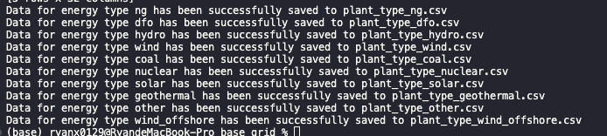
Ten different type of PLant
Separated into 10 files with different type of energy use
Ng = natural gas
Dfo = Distillate Fuel Oil
3 major = Hydro, Wind, Solar
Coal
Geothermal
Wind_offshore
Focus on comparison between (coal & ng) vs. 3 clean energy for goal

Slide 10
Guide for reading plant.csv data
Plant_id & bus_id = ID for plant to bus
Pg = Real Power Output
Qg = Reactive power output
Qmax/Qmin = Maximum/Min reactive power output
Vg = Voltage magnitude setpoint (Target to maintain)
MBase = Total MVA base of the machine (Capacity)
Status = Operational status of the plant (> 0 for in-service, <= 0 for out-of-service)
Pmax/Pmin = Maximum/Min real power output
Pc1/Pc2 = Lower/Upper real power output of PQ capability curve in MW
Qc1min/Qc1max = Minimum/Max reactive power output at PC1 in MVAr (lower end)
Qc2min/Qc2max = Minimum/Max reactive power output at PC2 in MVAr (upper end)
Ramp_agc = Ramp rate for load following/AGC in MW/min
Ramp_10/ramp_30 = Ramp rate for 10-minute / 30-min reserves in MW
Ramp_q = Ramp rate for reactive power in MVAr/min
Apf = Area participation factor
Mu_pmax / mu_pmin = Kuhn-Tucker multiplier on upper/lower real power output limit
Mu_qmax / mu_qmin = Kuhn-Tucker multiplier on upper/lower reactive power output limit
Type = type of fuel
GenFuelCost = Cost per MMBTu of input energy
GenOB = Linear coefficient of the heat rate curve in MMBTu/MW
GenOC = Quadratic coefficient of the heat rate curve in MMBTu/MW^2
GenOD = Cubic coefficient of the heat rate curve in MMBTu/MW^3

